Slide 1
k-means Clustering
Demo – 1
Week 5 Practical Sheet Question 1

Slide 2
What is k-means clustering?
k-means Clustering is a form of unsupervised learning, where the data is grouped into clusters.
We perform this learning algorithm, to group the data into k number clusters, upon analysis of which we might get insights about the data.
The k-means algorithm is as below:
Initialize the Cluster Centres.
Calculate which of the data points are closest to each of the clusters, and colour code them.
Move the Cluster Centres to the mean of the data points that “belongs” to it.
Repeat the process until the Cluster Centres don’t change for two or more iterations.

Slide 3
1. Initialization of Clusters
First, we must determine how many Clusters our data needs to be separated by (Optimal K).
Two methods for doing this are:
Elbow Curve Method
Silhouette Analysis
After this, K random points are selected, to use as starting Cluster Centres.

Slide 4
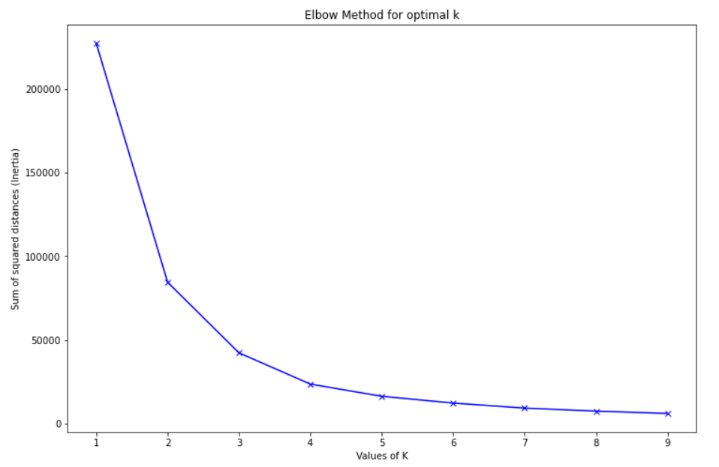
Elbow Curve Method
For this method, we need to calculate the Within-Cluster-Sum of Squared Errors (WSS) for different values of k.
WSS Score = sum of the squares of the distances of each point from its predicted cluster point.
For the given height weight dataset, performing the WSS score calculation, the plot is as:
Here we see that the graph drops around K = 2, K = 3 and K = 4. This is a little ambiguous. So we turn to use the Silhouette Analysis method.

Slide 5
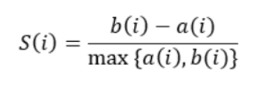

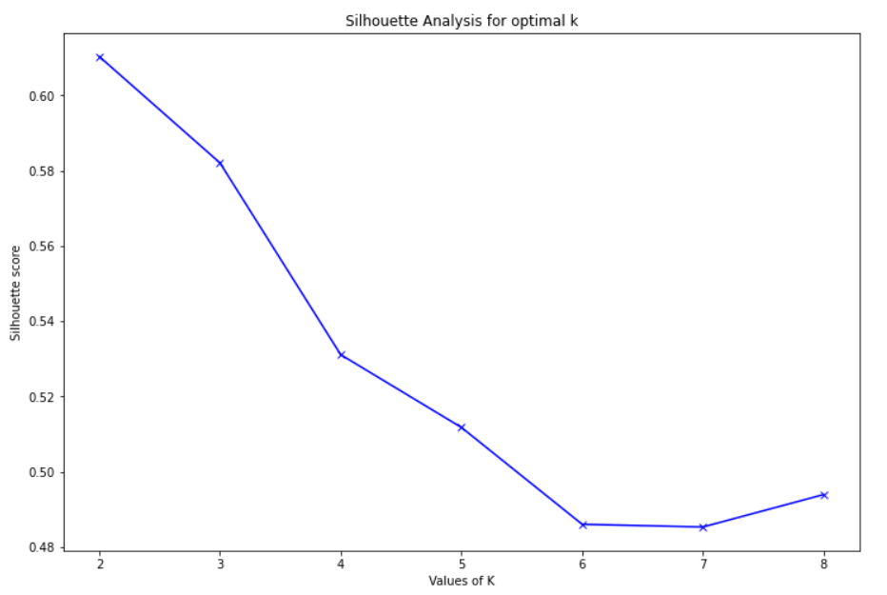
Silhouette Analysis Method
In this method, we check how close a point is to its cluster, compared to other clusters.
This method is used to get more confidence in determining the number of Clusters to use.
The value of the silhouette score is between -1 and 1.
1 means: The data point is very close to its cluster
-1 means: The data point is nowhere close to its cluster
0 mean: Clusters are overlapping.
For the given height weight dataset, the silhouette score is plotted against a different number of clusters as follows:
We see that the silhouette score is maximum at 2. This means that for the given dataset, 2 Clusters are optimal.

Slide 6
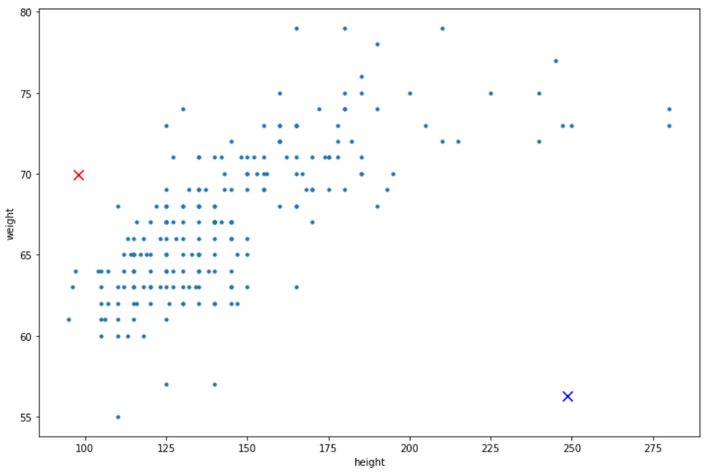
Initial Cluster Centres or centroids are selected randomly from the given dataset.
These centroids are plotted along with the data points as seen below:

Slide 7
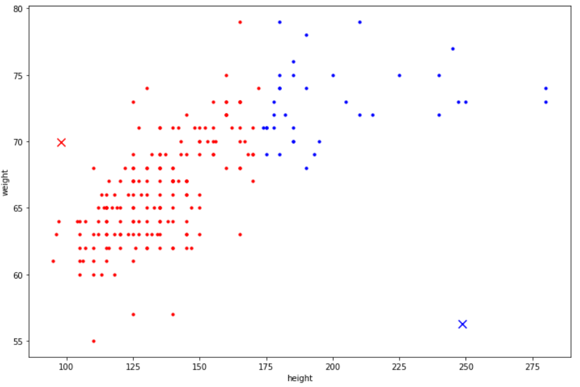
Calculating which data points are closest to the given clusters, and color coding them accordingly:

Slide 8
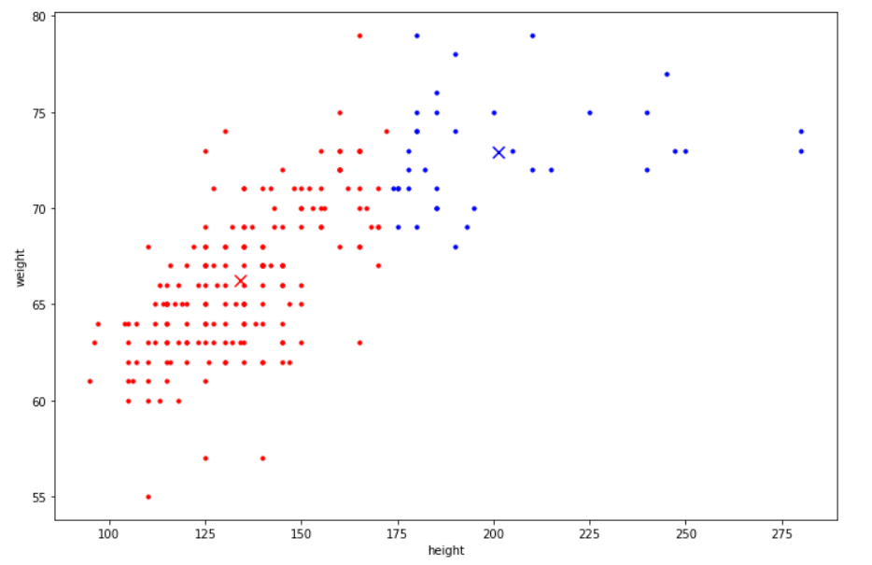
Calculating the means of the two clusters of datapoints, and moving the Cluster Centres there:

Slide 9
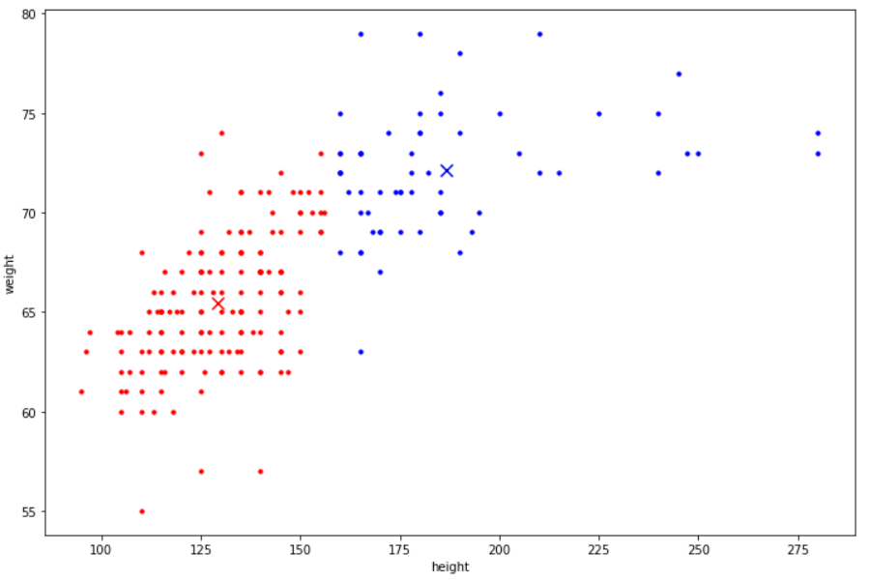
We repeat this process until the Cluster Centres don’t change any more.
The process took 8 iterations to confirm that the Cluster Centres obtained do not change further.
The final plot after k-means Clustering is:

Slide 10
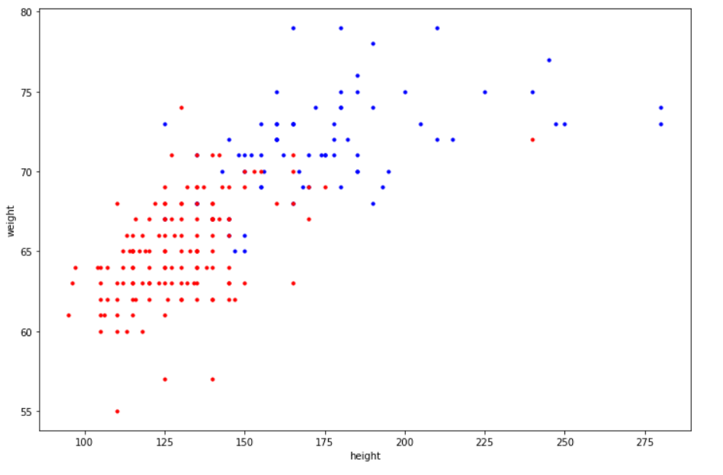
The Clusters 1 and 2 given in the heightWeightData.csv file, give the plot as seen below:
We can conclude that the k-means clustering algorithm performed by us has been efficient in clustering the data into two.

